Slide 1

CUSTOMER TRANSACTION ANALYSIS
Presented by: Nguyen Vo Thuy Hang

Slide 2

Table of content
01
02
03
04
Project Description
Data Overview
Exploratory Data Analysis
Descriptive Analysis
05
06
07
08
Sales Prediction
Customer
Segmentation
Conclusion
Suggestion

Slide 3


1.Project Description
The Customer Transaction Analysis project aims to leverage data analytics for data-driven business decision-making. It seeks to understand customer behavior and sales trends to optimize marketing strategies, enhance customer experiences, and predict future sales performance.

Slide 4
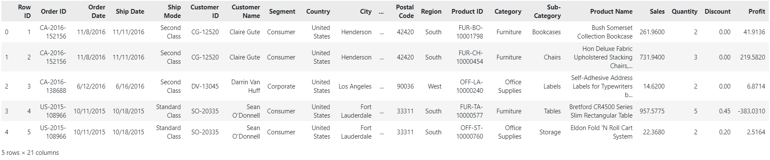
2. Data Overview
The dataset contains 9994 rows and 21 columns, with the following key attributes:
Index-based information like Order ID, Order Date, Ship Date, Customer ID, Product ID, and Postal Code.
Order-related attributes, including Ship Mode, Sales, Quantity, Discount, and Profit.
Customer details such as Customer Name, Country, City, State, Region, and Segment.
Product specifics encompass Category, Sub-Category, and Product Name.
Figure: First 5 rows and several columns of the dataset

Slide 5
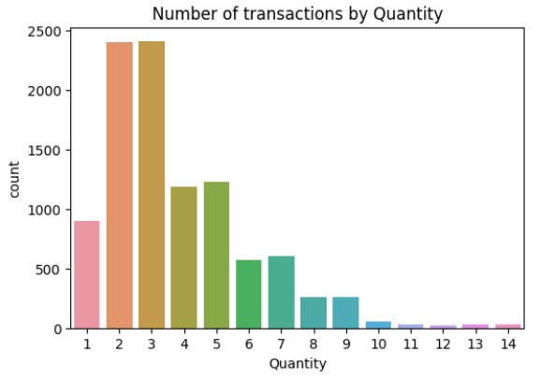
3. Exploratory Data Analysis
3.1 Orders, Products, and Customers
There were 5009 orders, 793 distinct customers, and 1862 products were sold from 2014 to 2017.
3.2 Quantity
The most common quantities were 2 and 3, making up about 50% of transactions. Quantities of 4 and 5 were less popular. Quantities higher than 10 were infrequent, occurring in only a few transactions.

Slide 6
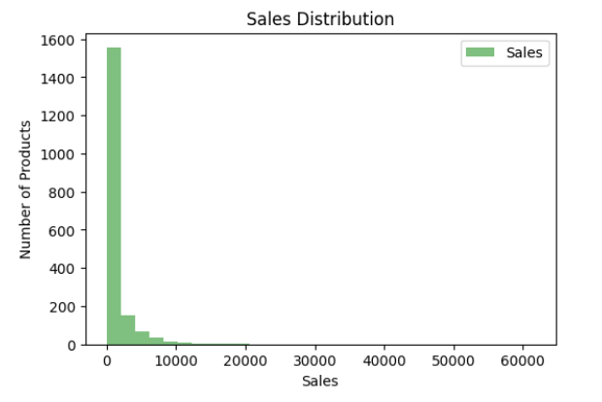
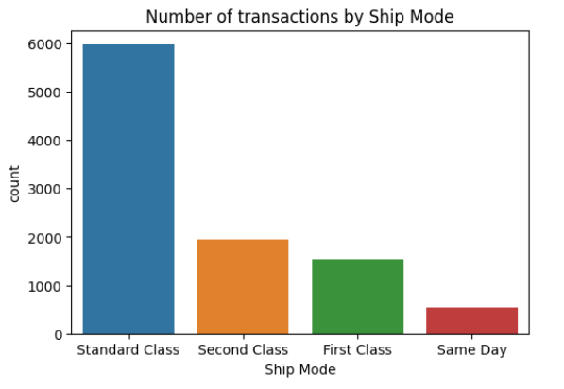
3. Exploratory Data Analysis
3.3 Sales
3.4 Ship Mode
Most products were sold under 10000 USD, especially the sale of nearly 1600 products were less than 2500 USD.
Standard Class was the most popular shipping mode, followed by Second Class and First Class respectively. The Same Day option was the least preferred.

Slide 7
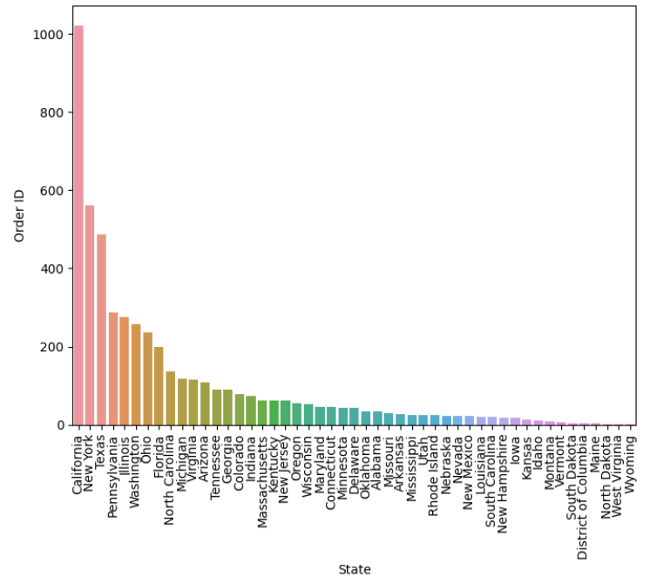
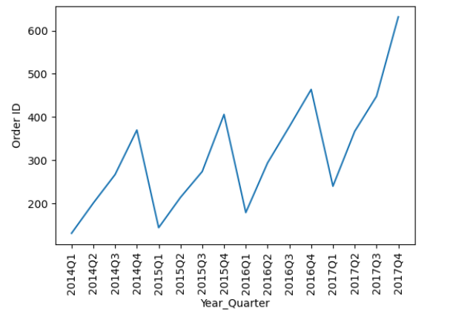
4. Descriptive Analysis
4.1 Total Orders by States
4.2 Total Orders by Quarters and Years
Shopping activities were highly frequent in large states, particularly California, New York, and Texas respectively. The remaining states had a small number of orders.
Customer shopping activity tends to increase towards the end of the year.

Slide 8
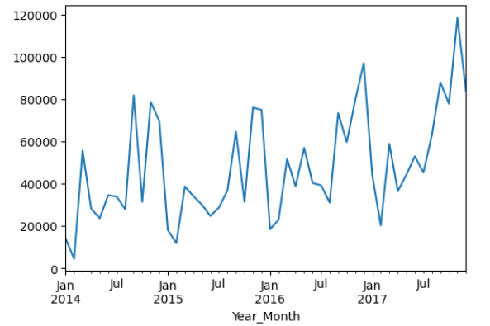
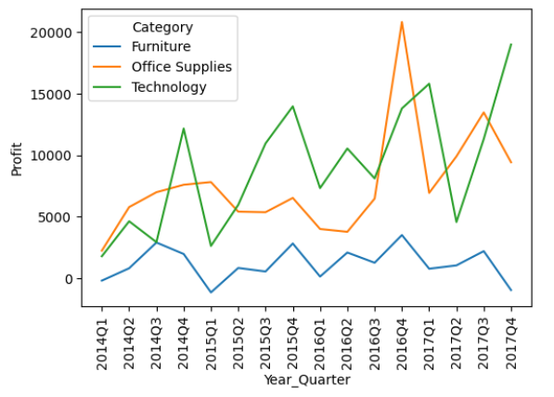
4. Descriptive Analysis
4.3 Sales over months and years
4.4 Profit by Quarter and Category
A year-end rise in customer spending, with lower shopping activity in the first half of the year.
Customers prefer Technology over Office Supplies and Furniture.

Slide 9
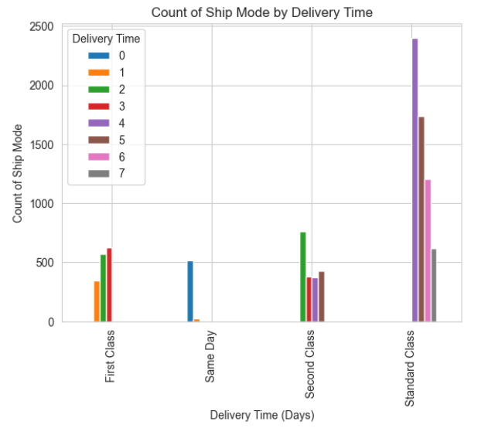
4. Descriptive Analysis
4.5 Time delivery by Ship Mode
The Standard Class, with a delivery time of 4 to 7 days, was the most frequently chosen shipping mode compared to Same Day, First Class, and Second Class.

Slide 10

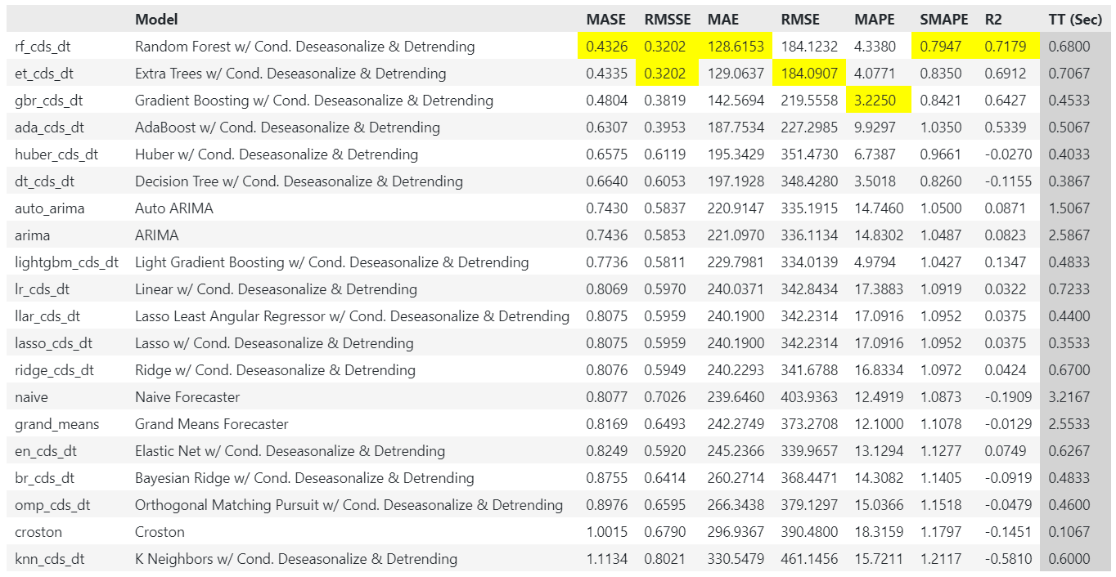
5. Sales Prediction
Use Pycaret library to perform sales in 2018.
Best model: Random Forest gets the lowest MASE, MAE, and highest R2 score

Slide 11
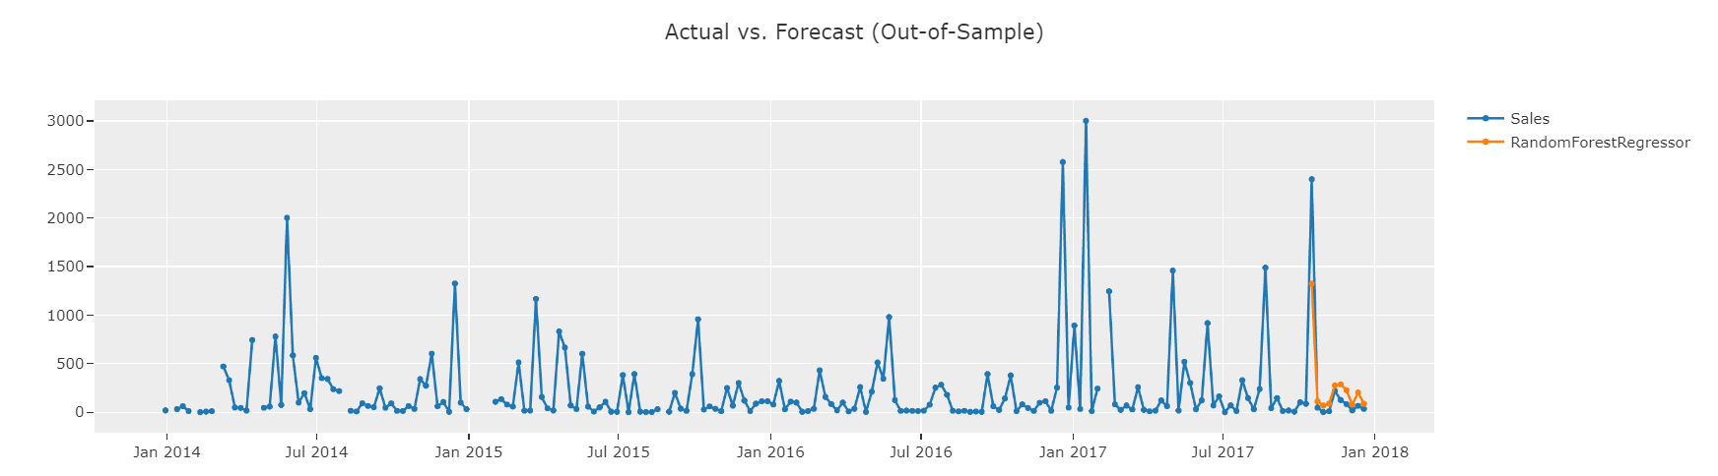
5. Sales Prediction in 2018
This model is only capable of predicting shorter periods, such as the next week or two weeks, and can’t make predictions weeks or months into the future.

Slide 12
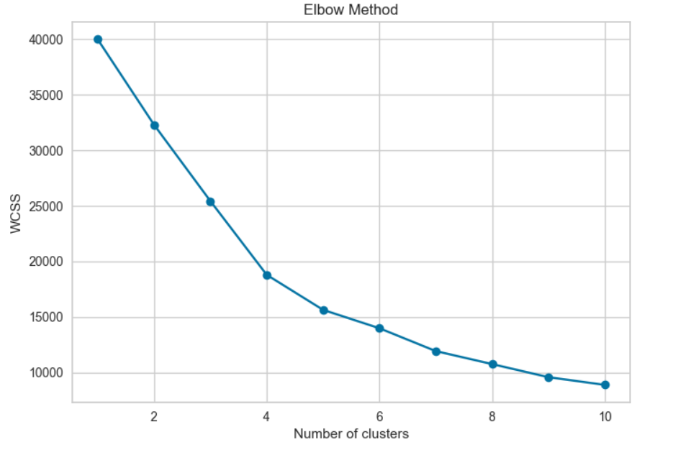
6. Customer Segmentation
Use unsupervised learning, particularly the K-means clustering method.
Select features like 'Sales,' 'Quantity,' 'Discount,' and 'Profit' are important for customer segmentation, as they capture purchasing behavior and profitability.
Apply the Elbow method to select the appropriate clusters where the change in WCSS begins to level off. In this case, the “Elbow” is located between 3 and 5, indicating that choosing 4 is a good fit.

Slide 13
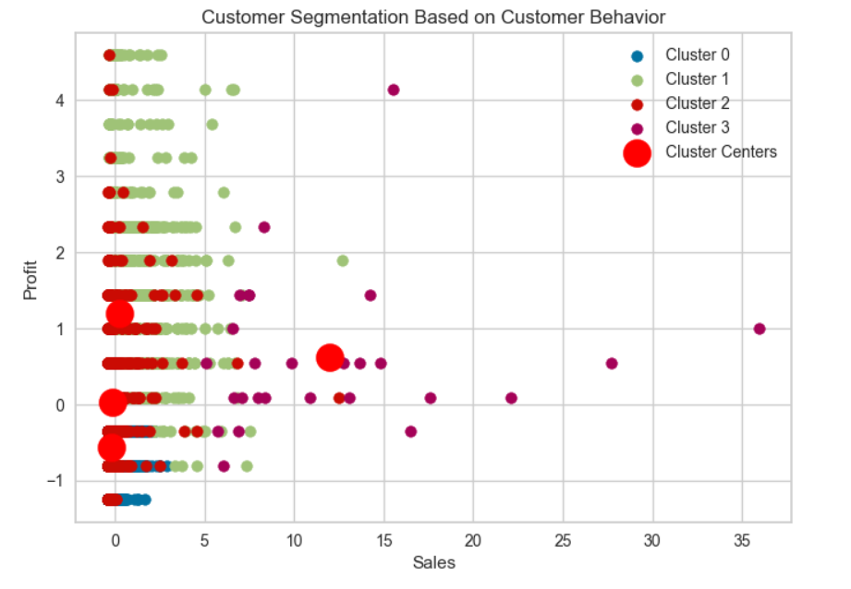
4 groups of customers through a scatter plot

Slide 14
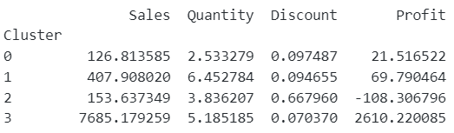
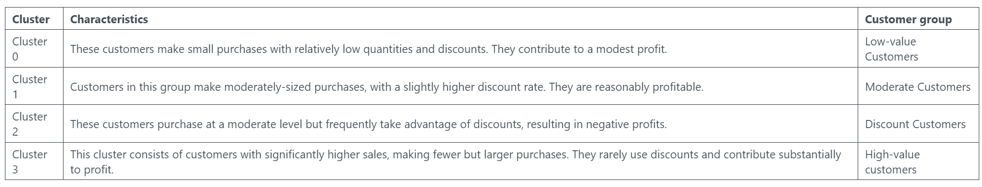
6. Customer Segmentation

Slide 15

Conclusion
Shopping activities were more frequent in big states such as California, New York, and Texas.
Orders peaked in the fourth quarter, requiring a year-end strategy.
Sales had an upward trend over the years.
Customers had a habit of spending more at the end of the year, especially purchasing Technology products.
The Standard Class was the most common Ship mode, with time delivery from 4 to 7 days.
Classify customers into 4 groups to understand customer behaviors.

Slide 16

Suggestion
Focus on Cluster 1 (Moderate Customers) and Cluster 3 (High-value Customers)
Cluster 1
Cluster 3
Implement personalized marketing strategies based on historical purchase data
Consider loyalty programs designed for this cluster. Offer rewards, discounts, and exclusive rewards to encourage repeat purchasing activities.
Focus on efficient order processing and fast shipping to maintain customer satisfaction.
Establish a VIP program with exclusive products and events.
Customize rewards and incentives based on customer preferences.
Gain insight into their purchase history and preferences.
Provide personalized support through dedicated teams or managers.

Slide 17

Thanks For Listening and Watching

